Slide 1
Osteoarthritis Checkup System
Group ID - 3
Mentor: Dr. Trilok Chand
Group Members:
Aditya SID-18103075
Saarisht Thaman SID-18103063
Gaurav Sharma SID-18103050
Aditya Kumar SID-18103010

Slide 2
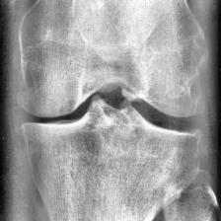
Motivation
Way too much time involved in the traditional method:
High population
Government vs Private Hospitals
Overhead of Medicine Practitioner
Artefacts on X-ray
Management of physical reports is difficult
Results Dependent on experience of Radiologist
Lack of proper infrastructure and services in rural regions

Slide 3
Features
Register/Login user
Generating New Report
Download/Print Report
User details and Report Management
View-Download-Search Patients Report’s based on
Serial No.
Gender
Grade
Name
Age
Change System’s Language( 108 languages including Hindi and Punjabi)

Slide 4
Diagrams

Slide 5
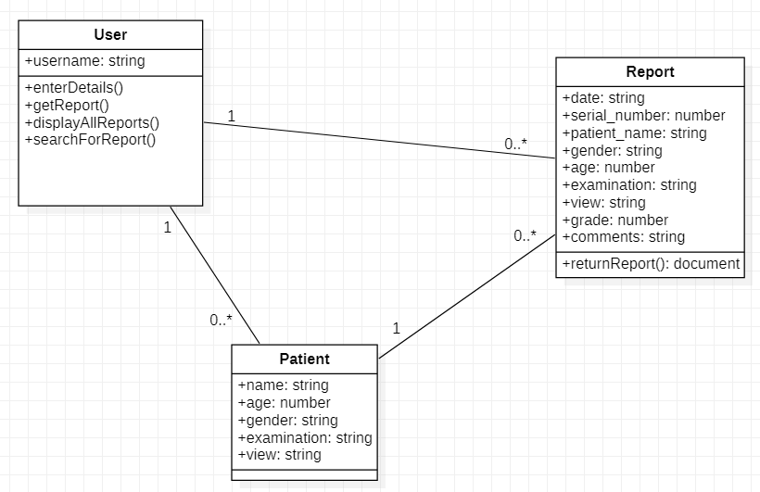
Class Diagram

Slide 6
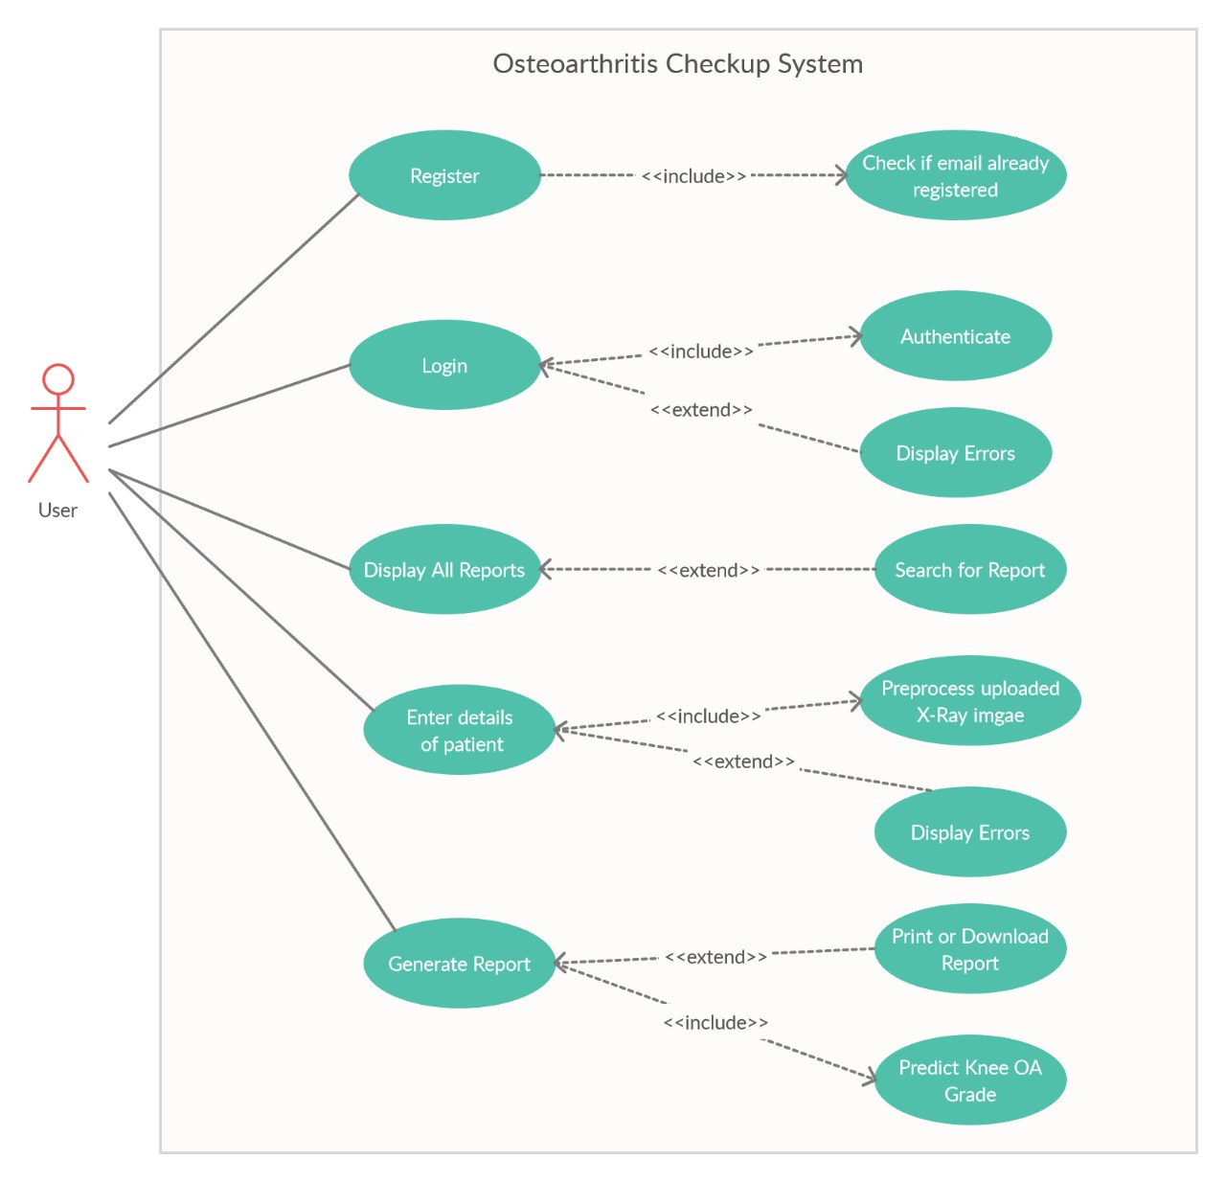
Use Case Diagram

Slide 7
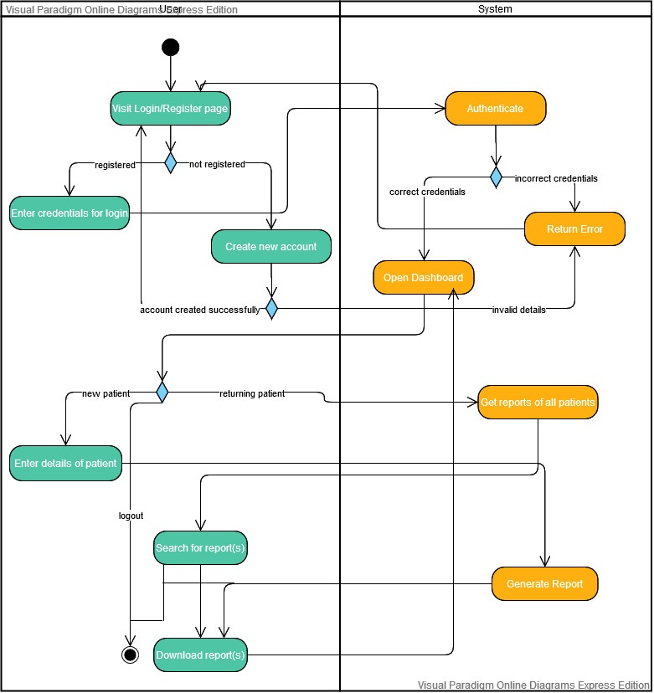
Activity Diagram

Slide 8
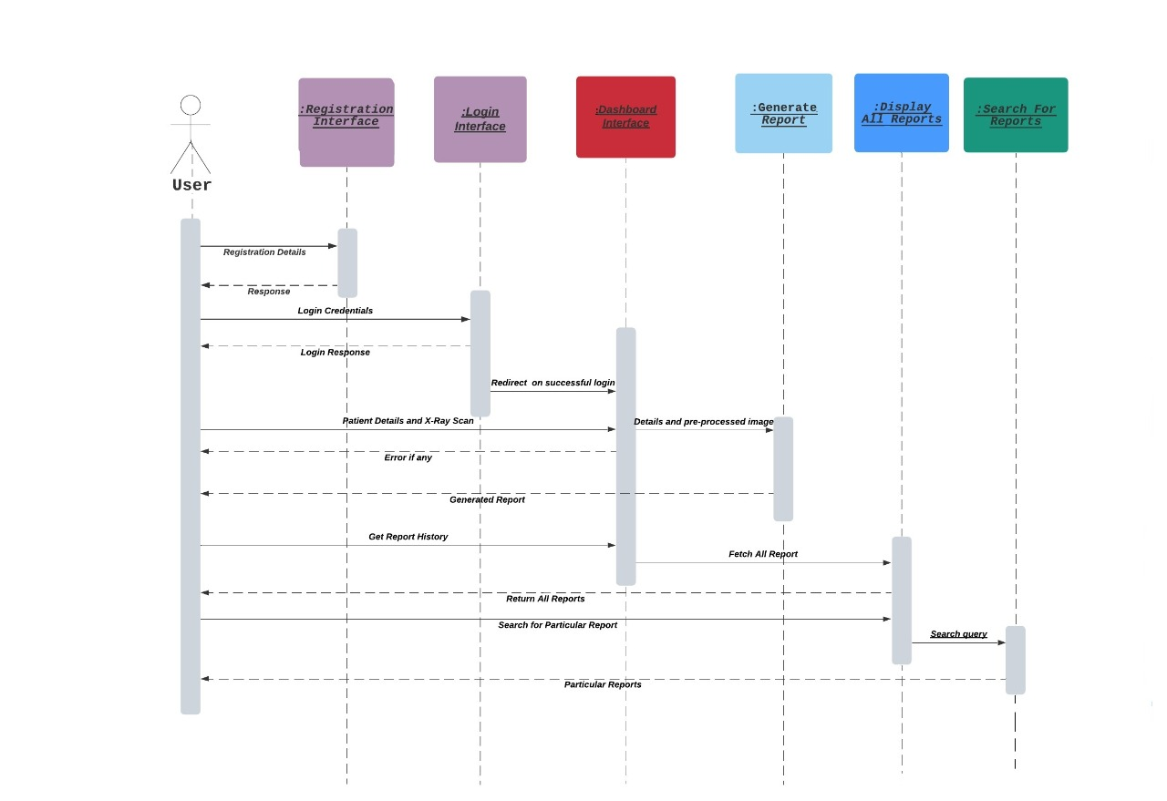
Sequence Diagram

Slide 9
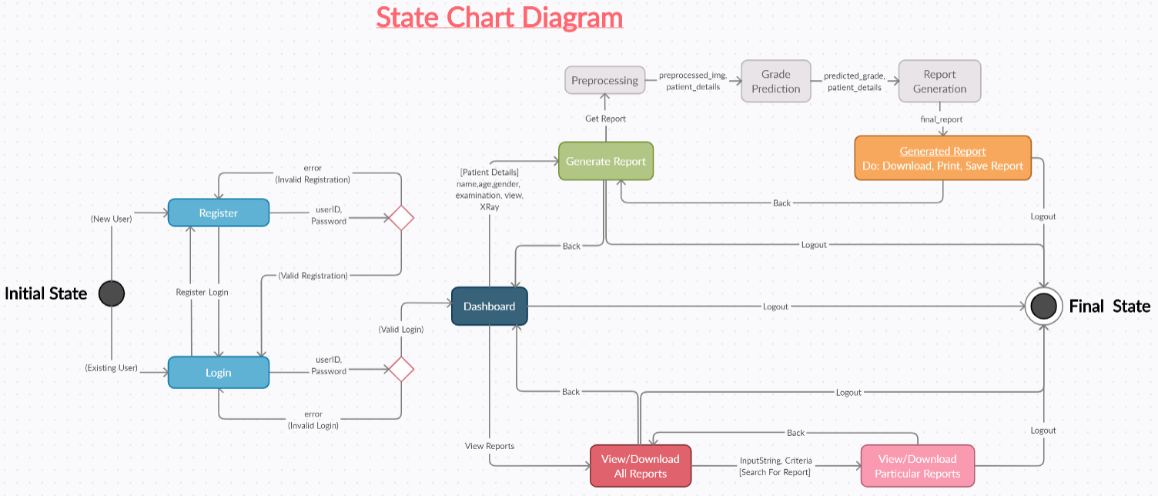

Slide 10
How System Utilizes Web Technology
System uses Node.js with Express framework at its Backend and HTML, CSS(Bootstrap), JavaScript at its Frontend.
On opening the web application, the user is greeted by a Login/Registration Page. The login system uses the passport local strategy to authenticate users and MongoDB is used as the database to store user information as well as patient information and report data. All the passwords are encrypted and thus made secure by bcryptjs.
On successfully logging in, the user gains access to the dashboard from which the user can generate a new report or visit old reports at his/her leisure. Most of the webpages are dynamic which is made possible by the EJS package in Node.
After entering the details of a new patient and uploading their X-ray scan, a Deep Learning Model predicts the Grade of Osteoarthritis using Python script on the basis of the given information and generates a HTML report which is converted into a PDF format using the puppeteer API. The user now has the option to print/download the report and save the information onto the database.
Going back to the dashboard, the details of the patient added and the report can be accessed from the View Reports section. The server queries the database for information and displays the information of all the patients in a tabular form. Reports can be re-downloaded from here and the user also has the option to search for patients according to their Serial No., name, age etc.
System also has the feature to change Language of the entire Interface using Google-Translate-Script. (137 languages including Hindi and Punjabi)
Finally, the user can Logout to end the session!

Slide 11
DEMO

Slide 12
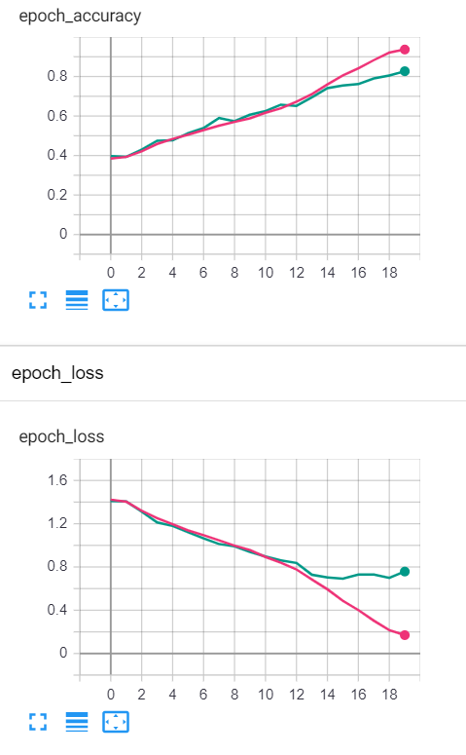
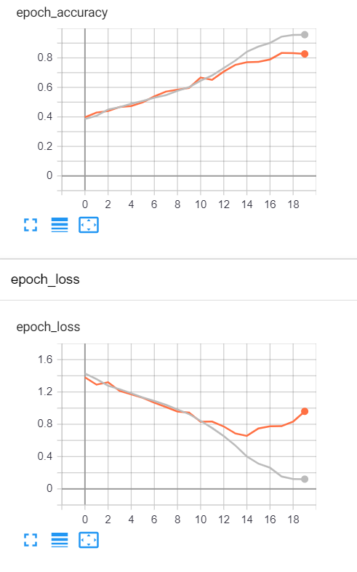
System Details
Our Model | Industry Standard Model
Size of the model is 108mb (Nearly 1/5th of Industry Standard Model) | Size of the model is more than 500mb
Accuracy of Model is 75.42% | Accuracy of Model stands at 69.7%
*on our system’s
pre-processing

Slide 13
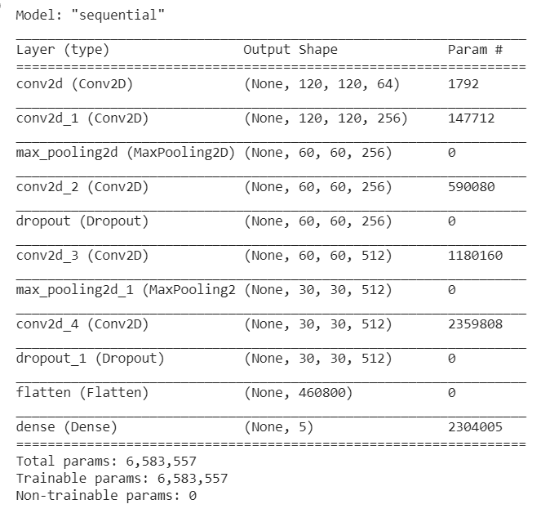
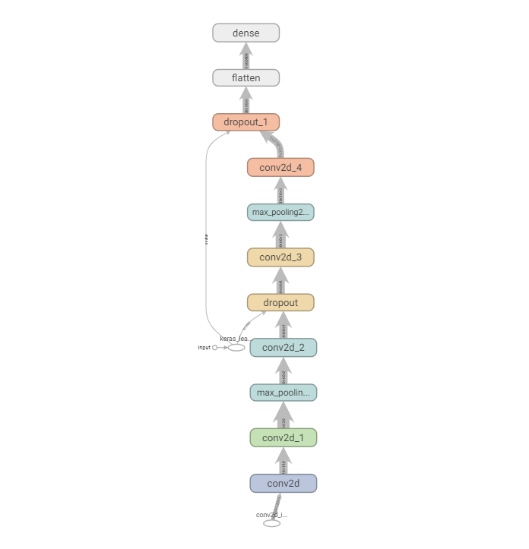

Slide 14
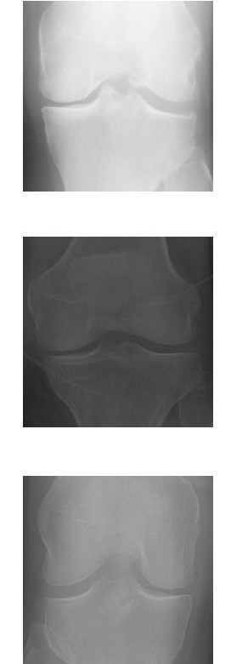
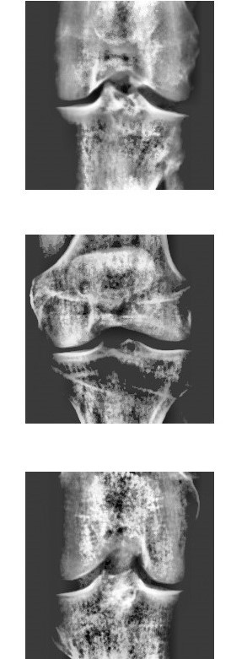
Original Image | Pre-processed Image

Slide 15
THANK YOU
GitHub Link: https://github.com/Gauravsharma-20/Minor-Project
Deployed At: https://oa-checkup-system.herokuapp.com/

